Slide 1
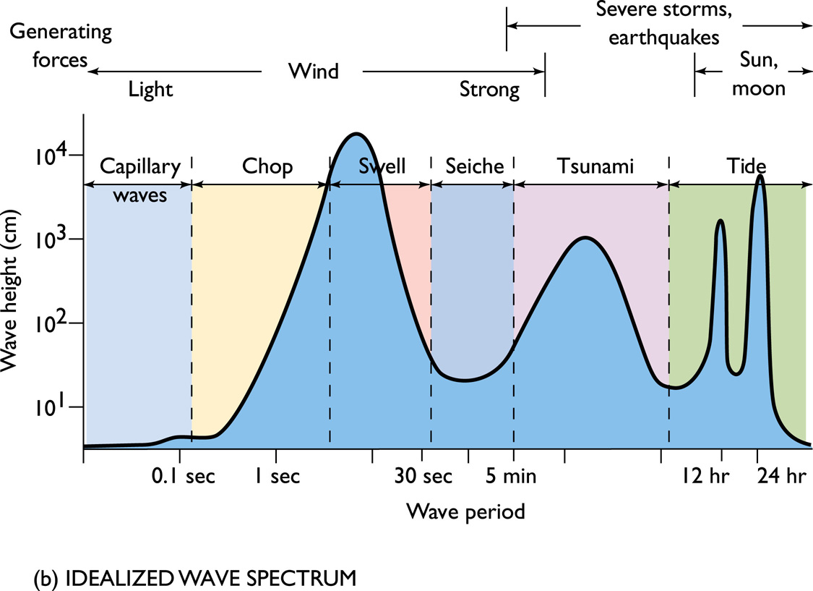

Slide 2
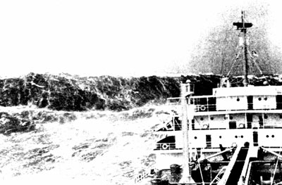
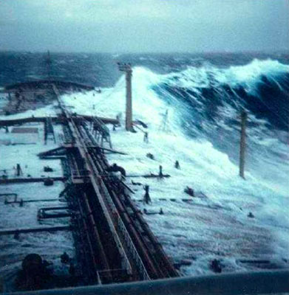
Ocean Waves
21 July 2004
This rare photo of a rogue wave was taken by first mate Philippe Lijour aboard the supertanker Esso Languedoc, during a storm off Durban in South Africa in 1980. The mast seen starboard in the photo stands 25 metres above mean sea level. The wave approached the ship from behind before breaking over the deck, but in this case caused only minor damage. The mean wave height at the time was between 5-10 metres.

Slide 3
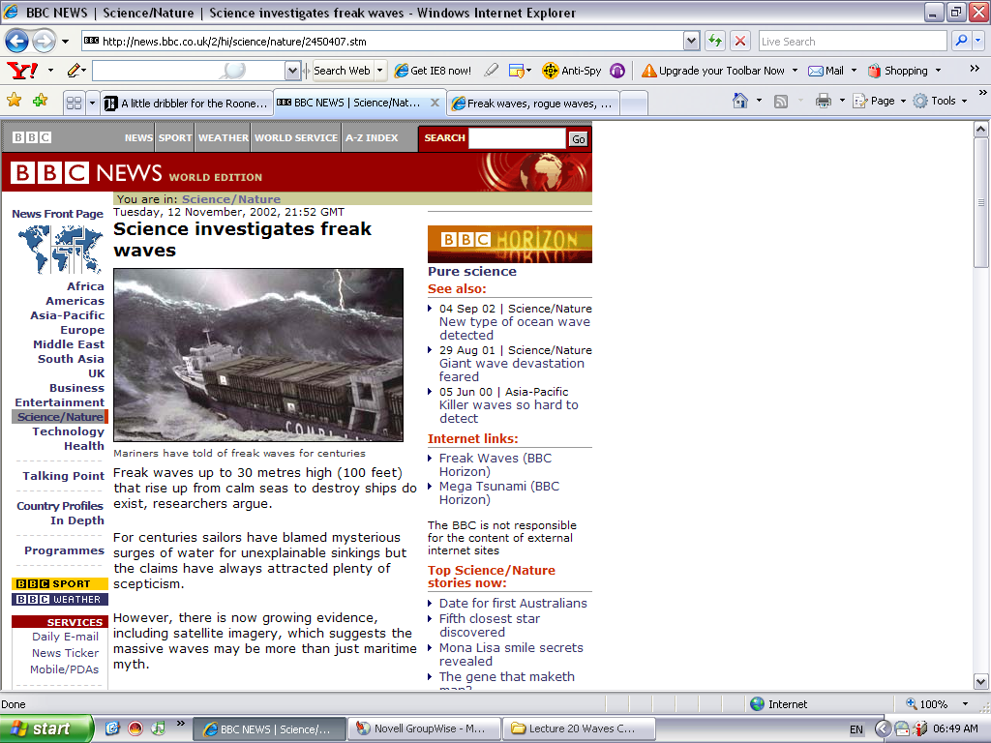
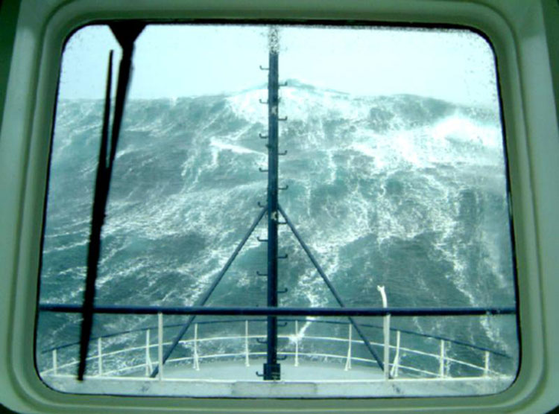

Slide 4
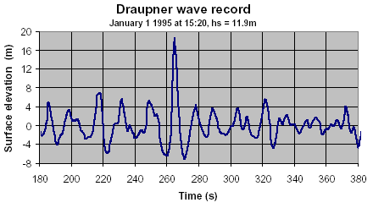

Slide 5
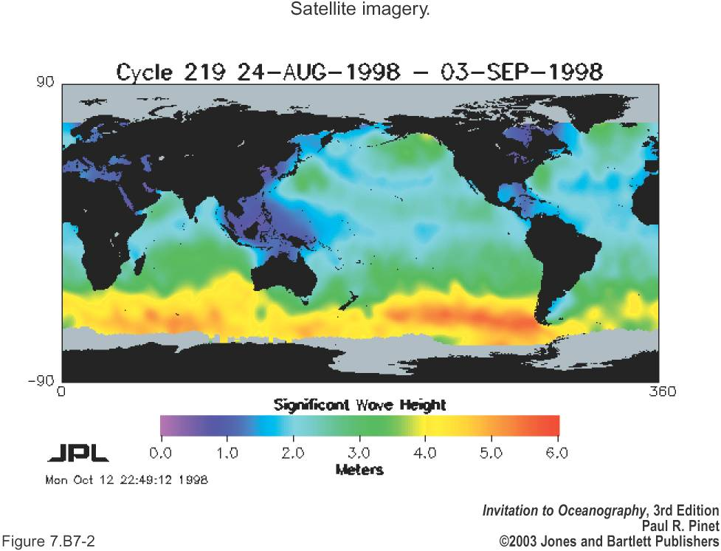
Significant Wave Height

Slide 6
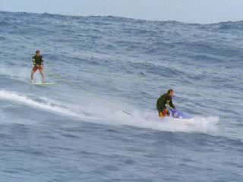

Slide 7
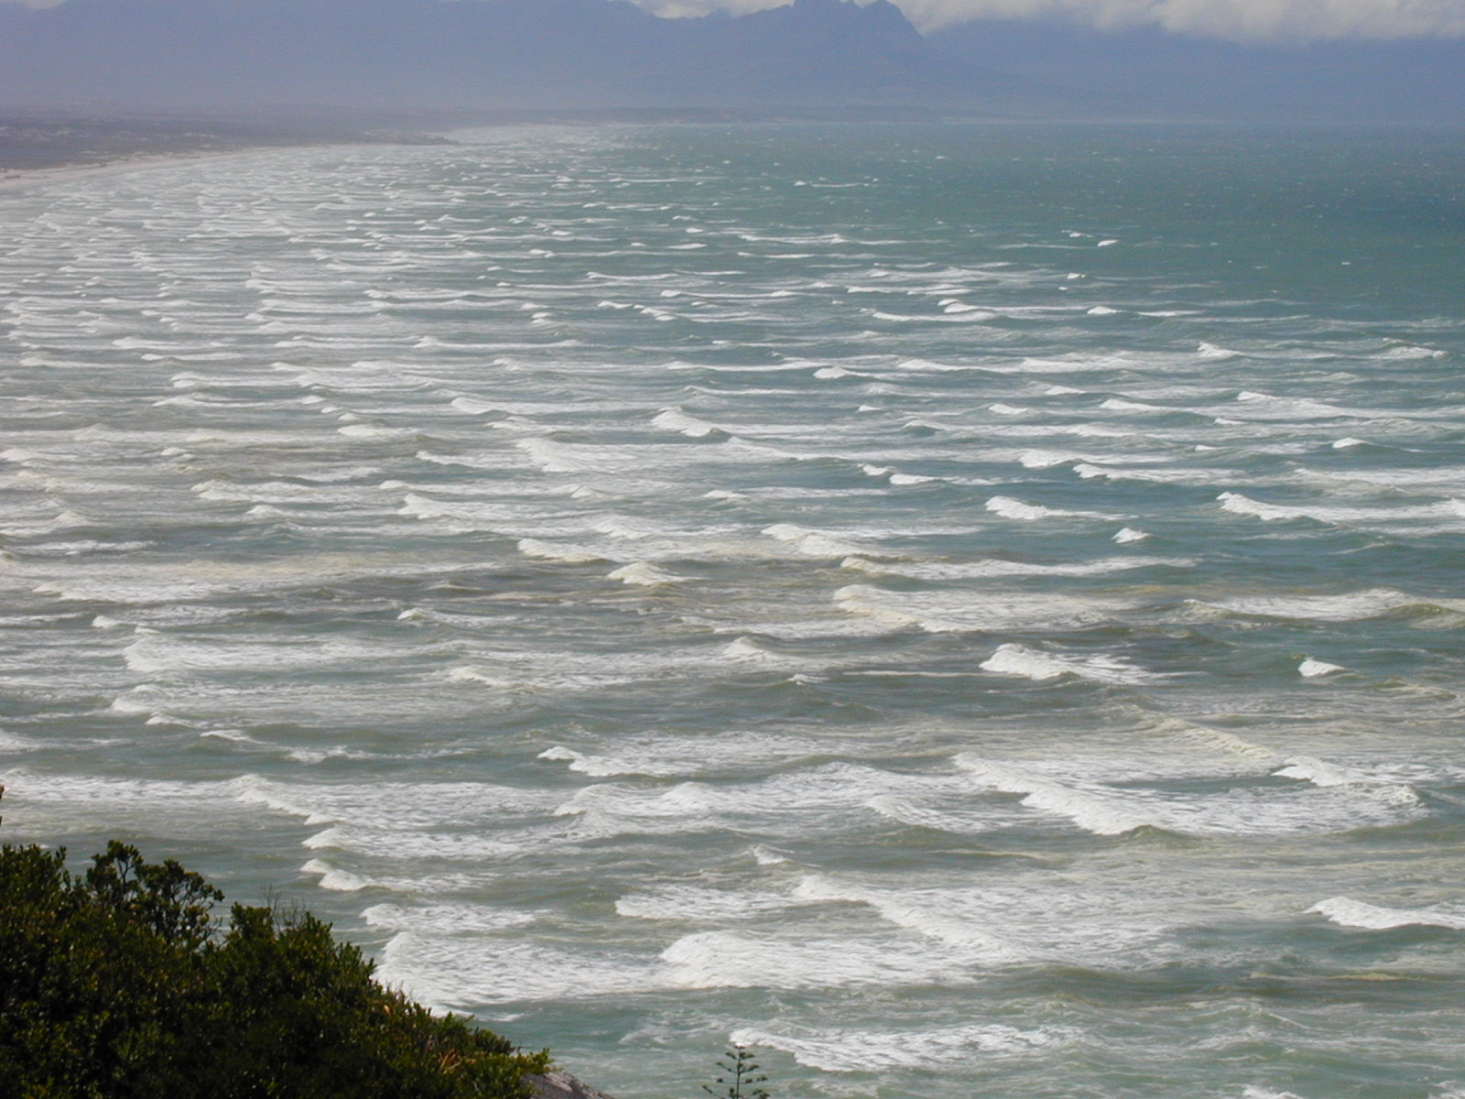

Slide 8
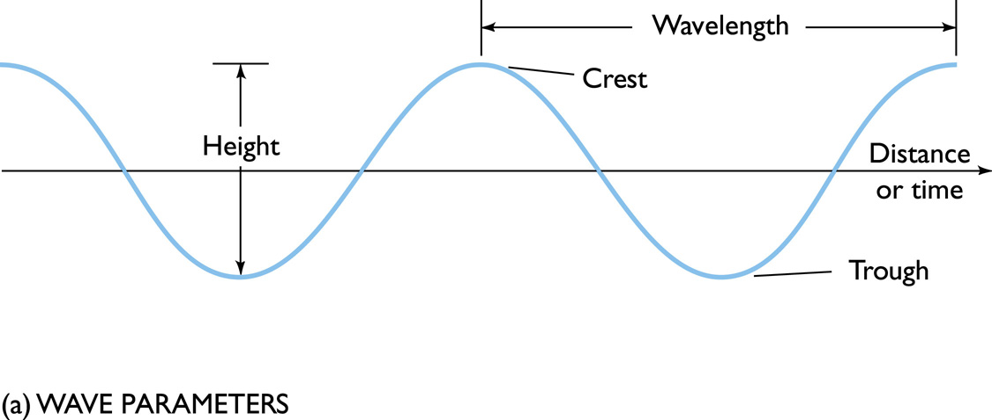
Wave Parameters

Slide 9
Properties of Ocean Waves
An ocean wave is an undulation of the sea surface.
Wave crest – highest part
Wave trough – lowest part
Wave height - overall vertical change in height between the crest and the trough (= 2 x amplitude)
Wave length - Distance between two successive crests
Wave period - time required for two successive crests or two successive troughs to pass a point in space
Progressive waves move across the sea surface.
Standing waves oscillate about a fixed point.

Slide 10
The number of peaks (or troughs) that pass a fixed point per second is the frequency

Slide 11
What Causes Waves?
Wind
Submarine disturbance (Tsunami)
Gravitational attraction of sun and moon (Tides)

Slide 12
Wind Generation of Waves
The type of wave generated by wind is determined by:
Wind velocity
Wind duration
Fetch (distance over which wind blows)
Simply put, wave size increases as the strength and duration of the wind, and distance over which it blows increases.
Wind-generated waves are progressive waves because they travel across the sea surface.

Slide 13
Progressive Wave Types
Sea - irregular waves in the area of generation
Swell - more regular waves beyond area of generation
Surf - waves that have reached the coast, grow in height, and break

Slide 14
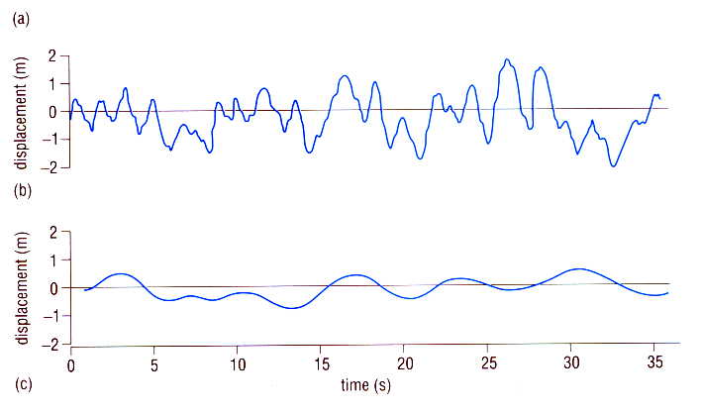
STORM
(b)
SWELL
(c)

Slide 15
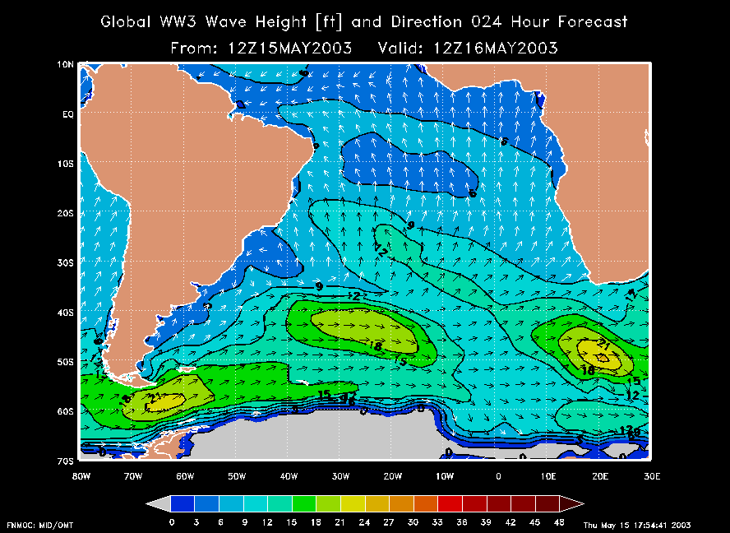

Slide 16
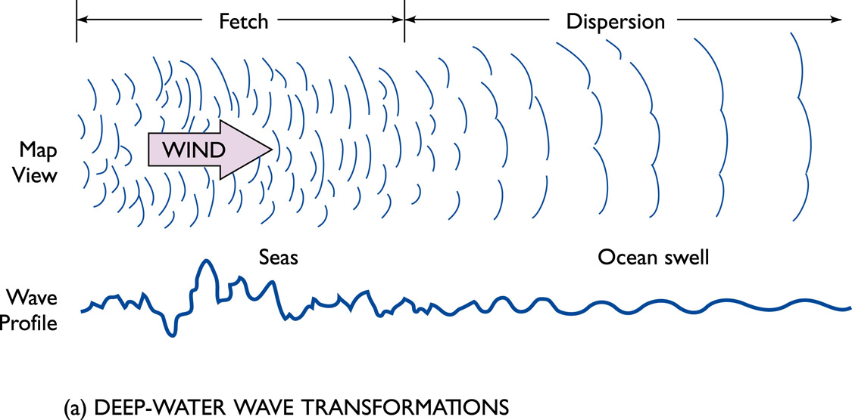
Transformation of Deep-water Waves: Dispersion

Slide 17
Wave Motions
Two basic motions associated with an ocean wave
The forward movement of the wave form.
The orbital motion of water particles beneath the wave.
It is wave energy not water molecules that moves across the sea surface.

Slide 18
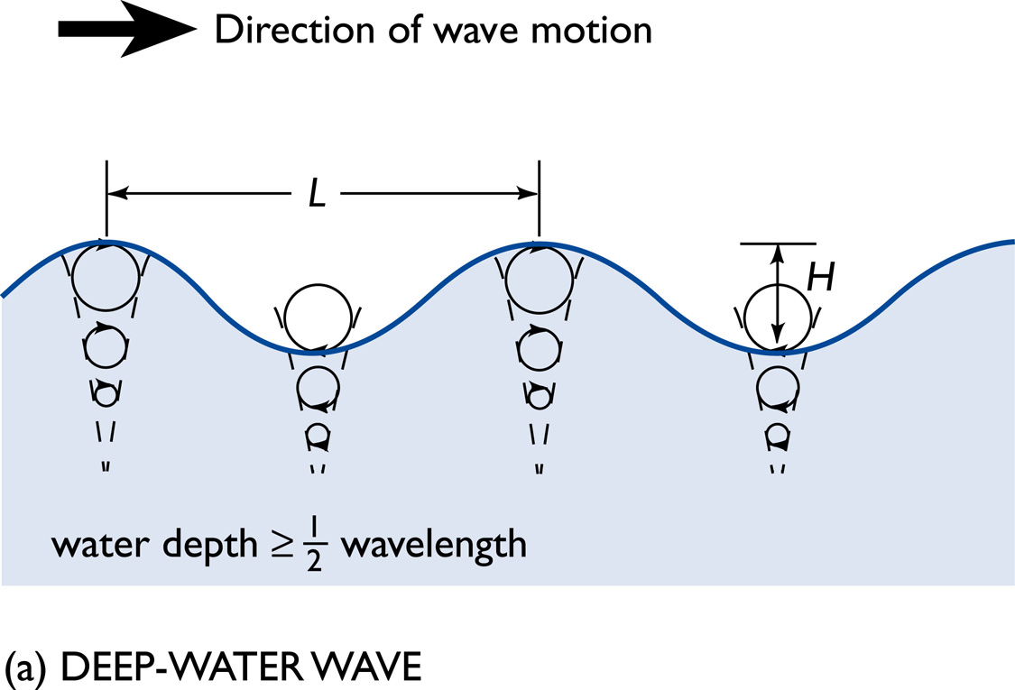
Deep Water Waves
Waves do not interact with the seafloor
Orbits of the water molecules are circular.

Slide 19
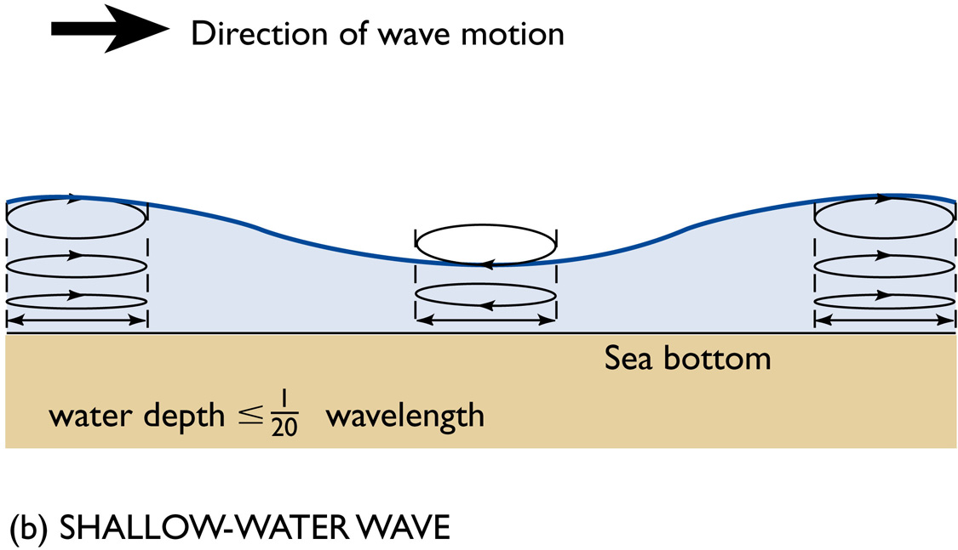
Shallow Water Waves
Waves interact with the seafloor are known as Orbits of the water molecules become elliptical.

Slide 20
Life History of Ocean Waves
Waves originate in the fetch area. This area is characterized by a “confused” sea state with extensive wave interference. This interference may be
Constructive
Destructive

Slide 21
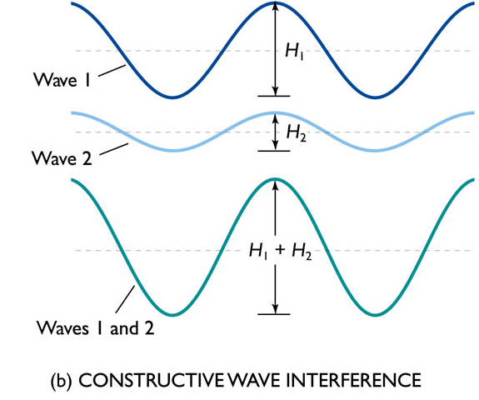
Rogue Waves?
Constructive wave interference occurs when several wave crests and/or troughs coincide. The crests build up and the troughs build down. Rogue waves!

Slide 22
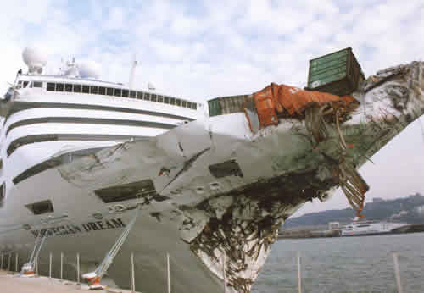

Slide 23
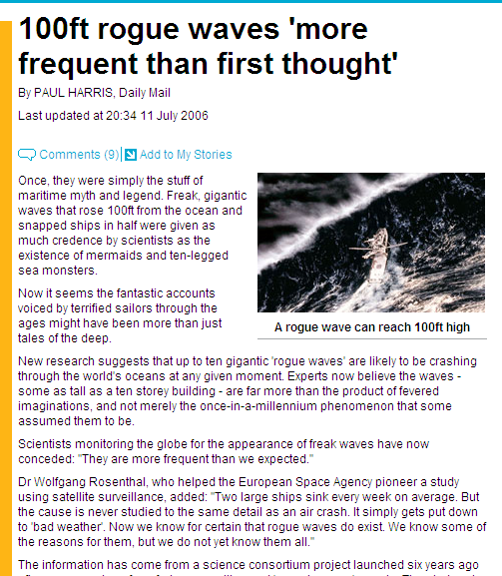

Slide 24
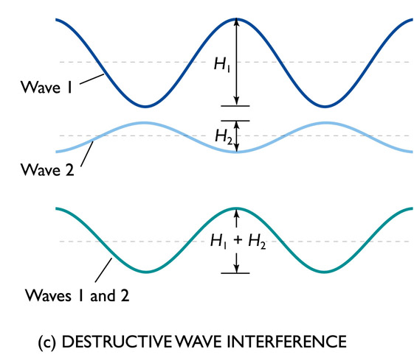
Destructive Waves
Destructive wave interference occurs when the crest of one wave coincides with the trough of another wave resulting in a cancellation or drop in wave height.

Slide 25
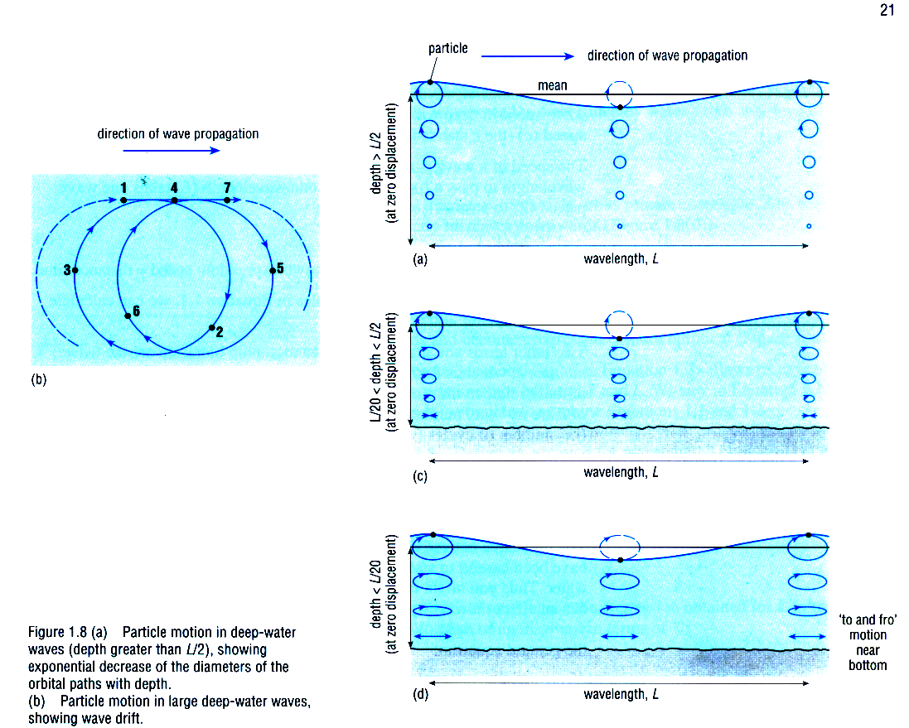
The particle orbit are not always circles !
DEEP OCEAN
Intermediate depth
SHALLOW WATERS

Slide 26
Symbolic description of Waves
period τ
frequency f = 1 / τ
wavelength λ
wave speed c = λ / τ
wave height H = 2A (A = amplitude = 50%H)
wave steepness Δ = H / λ

Slide 27
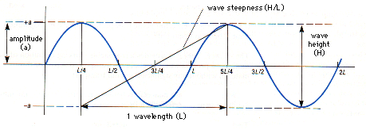

Slide 28
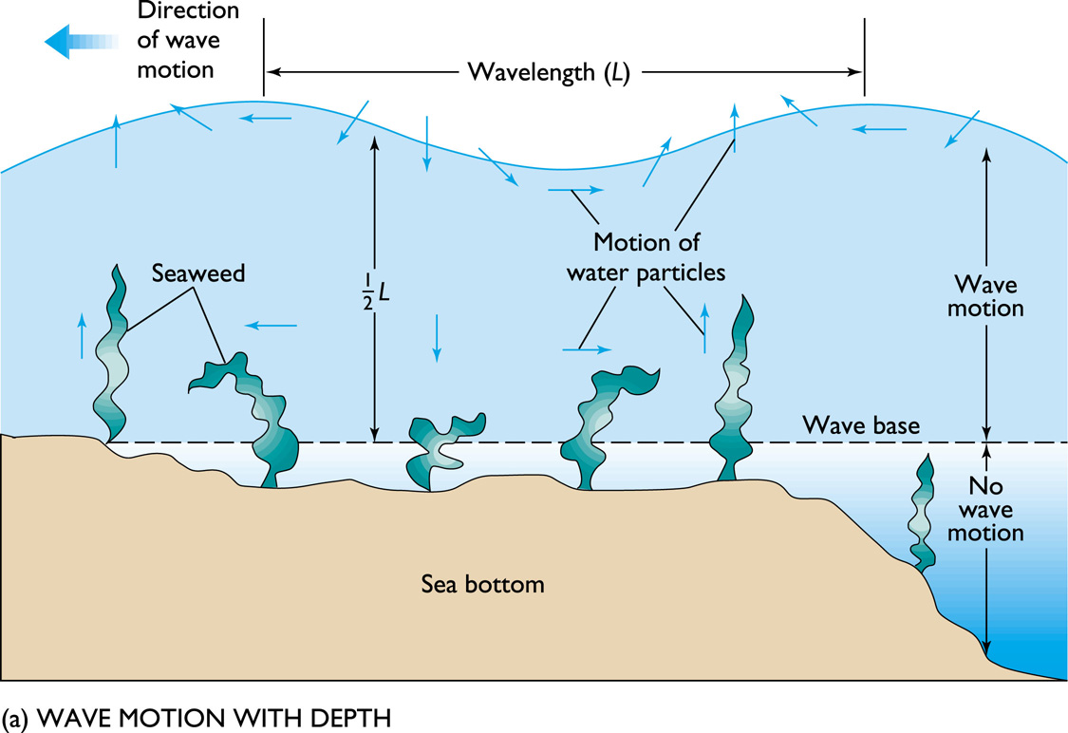
Wave Motion with Depth

Slide 29
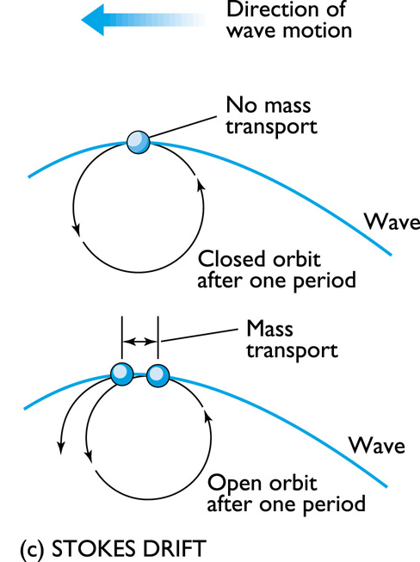
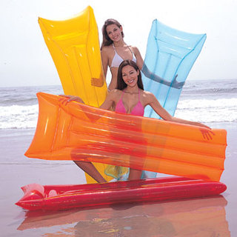
Motion of Water Particles
Wave form is really trochoidal (line form traced by a point on a rolling wheel)
Therefore orbits are only approximately circular -- there is a small net component of forward motion, particularly in large amplitude waves STOKES DRIFT

Slide 30
Two limits in wave speed
DEEP OCEAN
Depends on wavelength
G = gravity 9.8 ms, L = wavelength
Independent of wavelength
SHALLOW WATERS

Slide 31
Wave Speed
Deep water waves that have the greatest wavelengths and longest periods, travel the fastest and are the first to arrive in regions distant from the storm

Slide 32
Shallow Waves Affected by Bottom
In shallow water, the sea bottom transforms the wave’s properties. This leads to wave refraction and waves collapse forming surf (breakers).

Slide 33
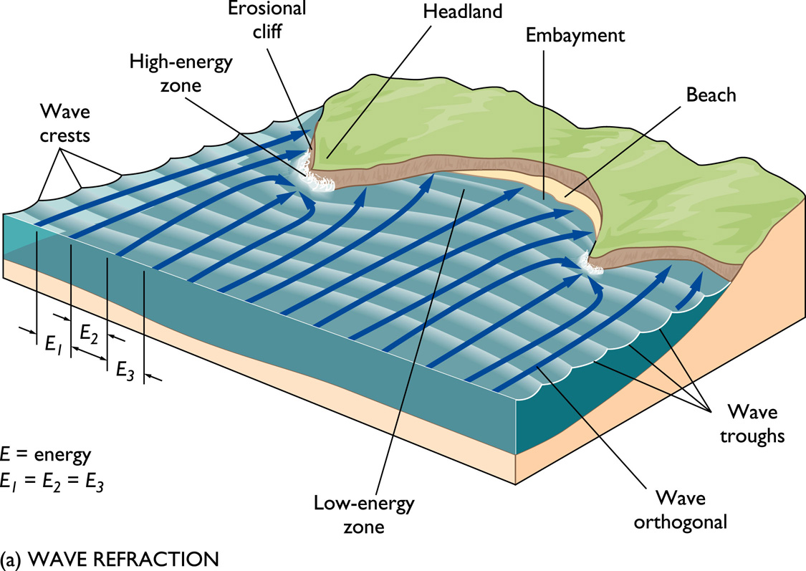
Wave Refraction
Bending of the wave crest as waves enter shallow water. It is due to
Drag along the bottom.
Differential speed along the crest – speed starts to slow down!.

Slide 34
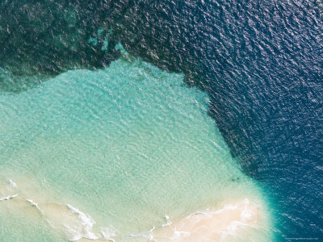

Slide 35
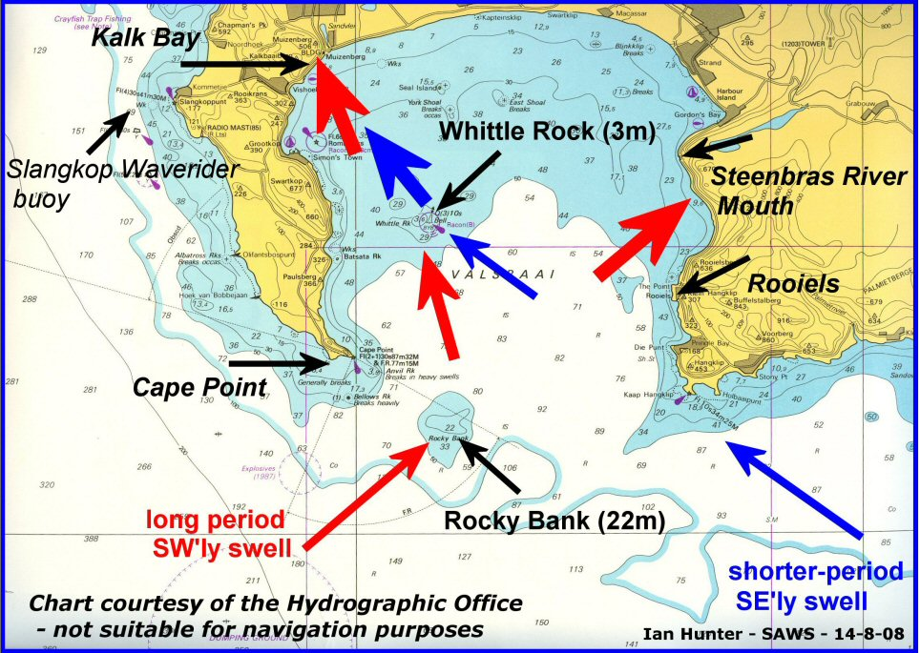

Slide 36
Shallow-water Wave Transformations
Interaction with the sea bottom.
Bottom friction alters both the
Wave form
Wavelength shortens (decreases)
Height increases
Celerity (speed)
decreases

Slide 37
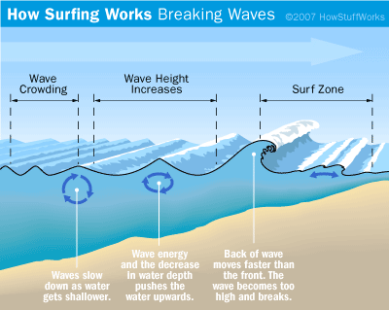

Slide 38
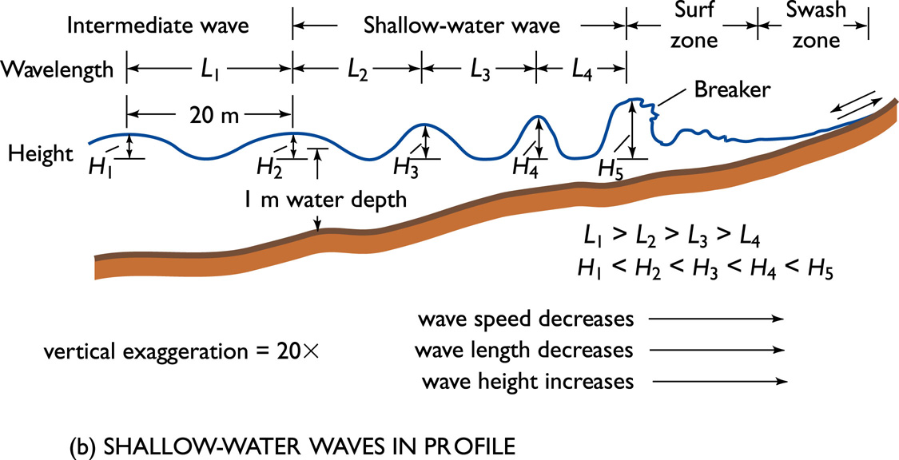
Transformation of Shallow-water Waves

Slide 39
Surf’s Up!
Shore breakers (surf) are collapsing waves. Breaking is determined by wave steepness
Wave height/wave length.
When this value is about 1/7, waves begin to break.

Slide 40

Waves Break Their form is dependent on the slope of the bottom!

Slide 41
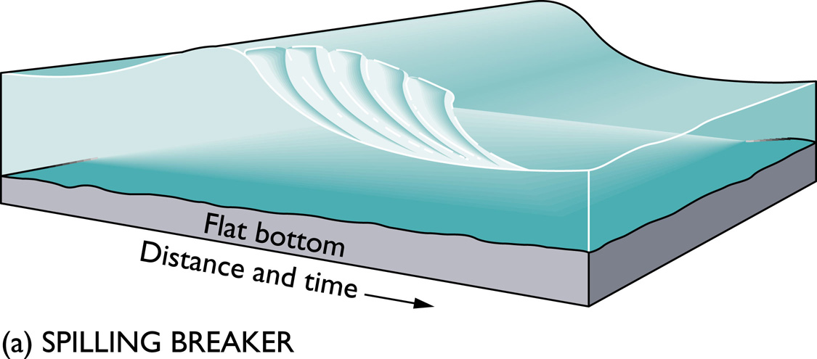
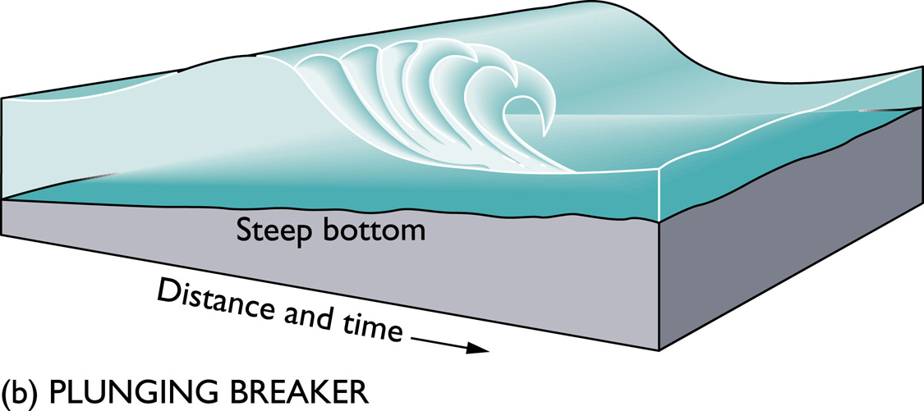
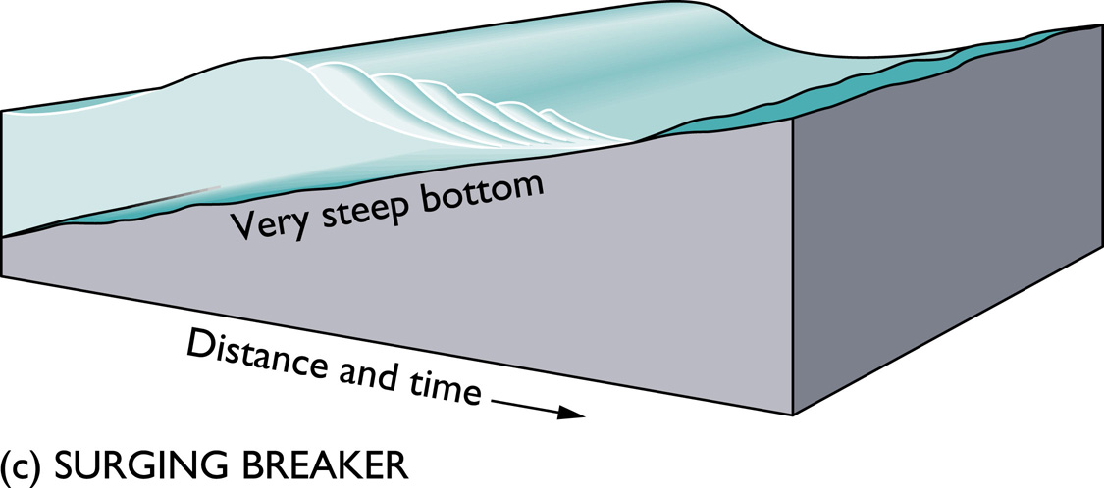
spilling breakers -- the crest moves forward faster than the wave as a whole; foam eventually covers the leading face of the wave; characteristically found on a gently sloping shoreline

Slide 42
plunging breakers -- the crest curls over and plunges downward with considerable force. Occurs on a steep slope

Slide 43
surging breakers -- crests remain relatively unbroken as the waves slide up the steep beach

Slide 44
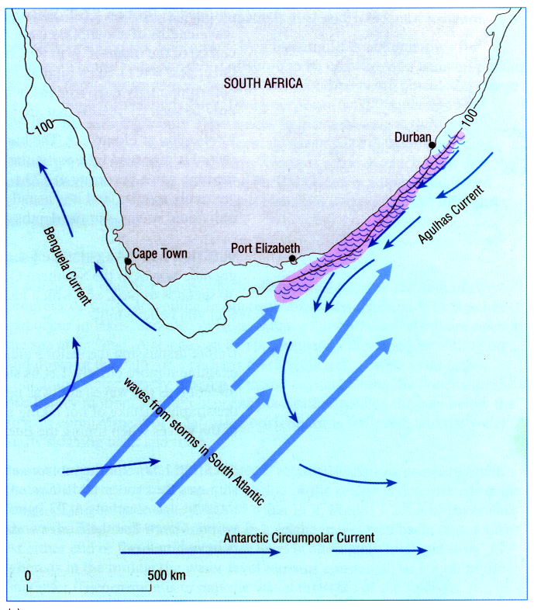

Slide 45
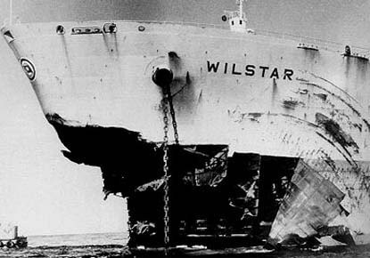

Slide 46
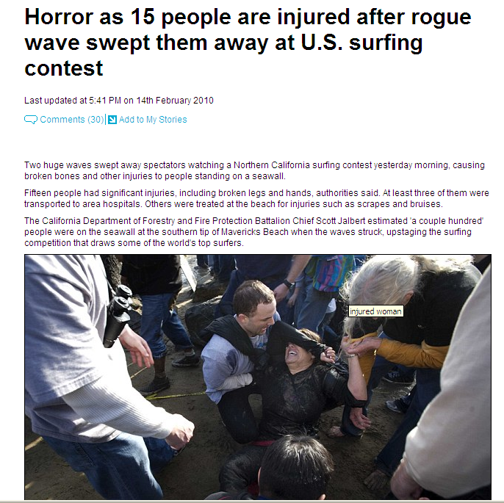

Slide 47
Wave Forecasting
The prediction of wave conditions in the ocean, usually based on output from a wave model.
1) hydrodynamic modeling of fluid motions, to compute the evolution of the water surface and fluid velocities, and to compute forces on structures;
2) modeling of the propagation of waves as they approach the shore, taking account of refraction by varying depth; and
3) modeling of the evolution of the spectrum of the wave energy divided into components of different frequency and direction, in order to forecast the waves over an ocean region.
Operationally, such models are used to produce wave forecasts (in much the same way as weather forecasts are produced) using wind information from meteorological forecast models.
Important for shipping, oil/gas platforms, fisheries, ports, surfers!

Slide 48
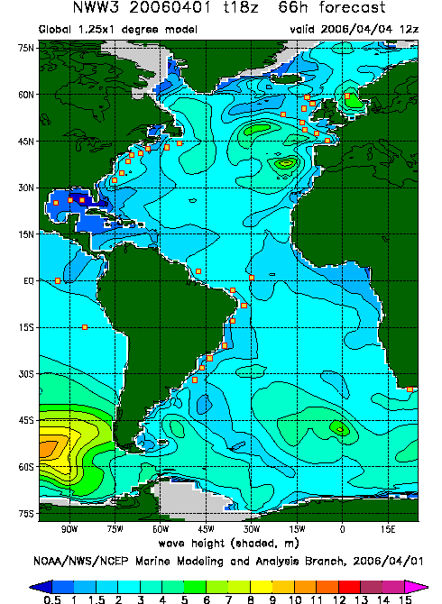

Slide 50
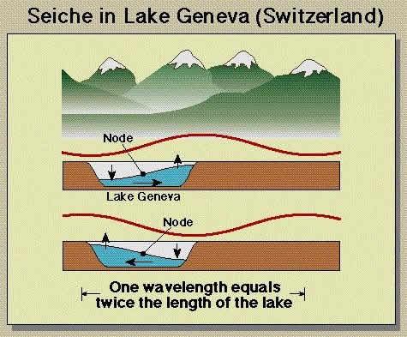
Seiches (sayshes)

Slide 51
Seiches
A wave that oscillates in lakes, bays, or gulfs from a few minutes to a few hours as a result of seismic or atmospheric disturbances.
caused by rocking of water confined in a small space -- this rocking occurs at a specific resonant frequency
because the wave oscillates vertically with no progressive (forward) movement, it is called a standing wave
standing waves are the sum of two progressive waves of equal dimension but traveling in opposite direction; occur in lakes, bays, estuaries and harbors which are open to the sea at one end

Slide 52
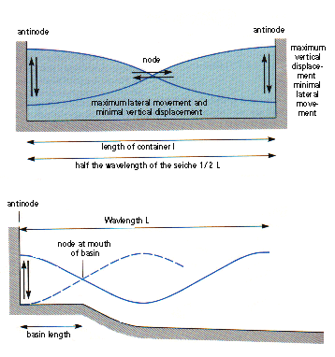
- at either end of the basin the water level is alternately high and low -- where the water level is constant (the node), the horizontal flow of water from one end of the basin to the other is greatest
- where the fluctuation of water is greatest (antinode), there is minimal horizontal movement of water

Slide 53
But if a basin is open at one end, it is possible for a node to occur at the entrance of the basin and an antinode at the landward end;
Water levels will then rhythmically oscillate between node and antinode and will result in damage on the landward side

Slide 54
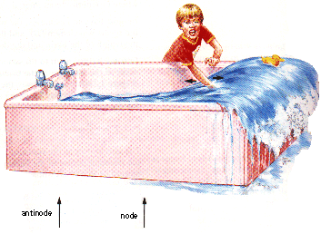

Slide 55
What causes waves to come in at intervals (sets)? It's not like the wave source (wind) blows in intervals, so why do the waves come in as sets?
The wind in the midst of storms usually does blow in intervals, called gusts.
The primary swell producing component is wind consistency. So the more the wind gusts above that range, the more that energy is transferred into the water. Once the swell leaves the storm-generating area, the swell energy bonds together and travels in groups of waves we call sets. The waves within the sets cycle together with other waves which helps to conserve their energy over vast distances of ocean.

